Slide 1
Neural Process Family
Kyeong Ryeol, Go
M.S. Candidate of OSI Lab

Slide 2
Contents
Conditional Neural Processes (CNP)
Neural Processes (NP)
Attentive Neural Processes (ANP)
Generative Query Networks (GQN)
Consistent Generative Query Networks (JUMP)
Sequential Neural Process (SNP)
Stochastic Process
Visual Scene representation
Video prediction
Temporal dynamics

Slide 3
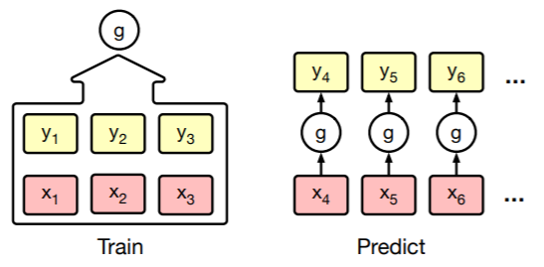
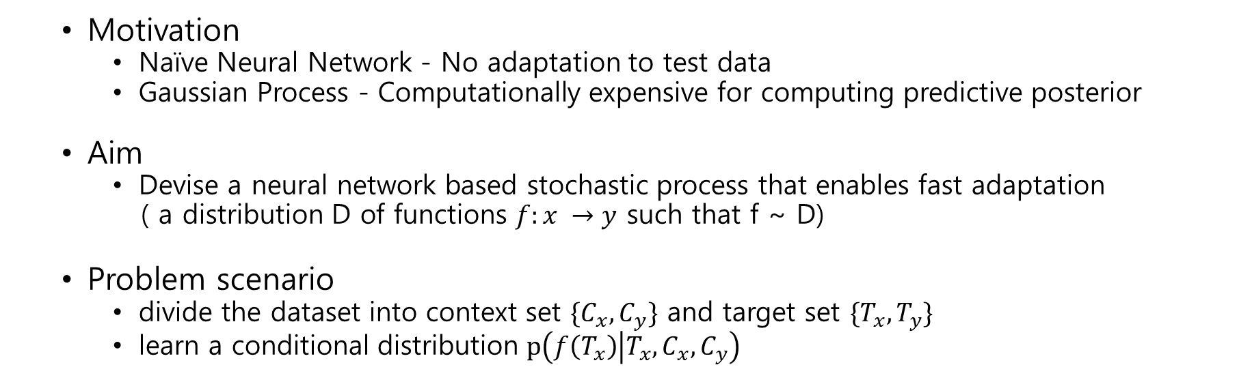
Family of Neural Processes
Motivation
Naïve Neural Network - No adaptation to test data
Gaussian Process - Computationally expensive for computing predictive posterior
Aim
Devise a neural network based stochastic process that enables fast adaptation
( a distribution D of functions $f:x →y$ such that f ~ D)
Problem scenario
divide the dataset into context set $\{C_{x}, C_{y}\}$ and target set $\{T_{x}, T_{y}\}$
learn a conditional distribution $p\left(f\left(T_{x}\right) | T_{x}, C_{x}, C_{y}\right)$

Slide 4
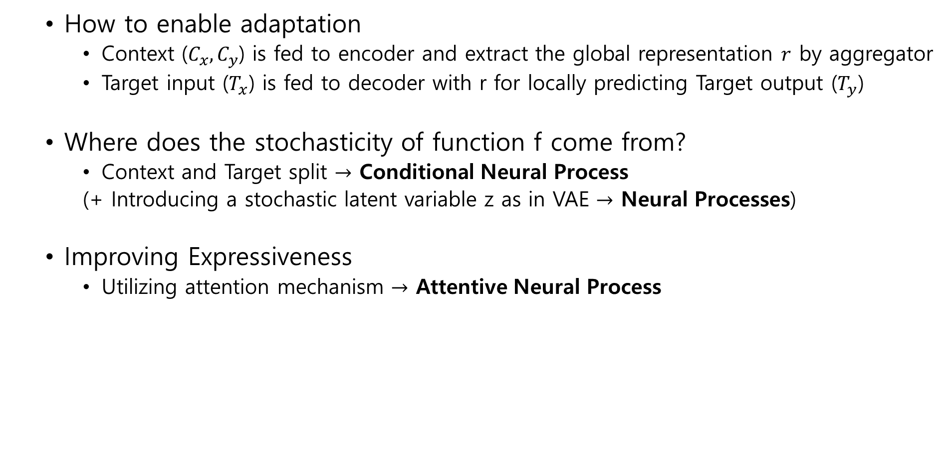
How to enable adaptation
Context ($C_{x}, C_{y}$) is fed to encoder and extract the global representation $r$ by aggregator
Target input ($T_{x}$) is fed to decoder with r for locally predicting Target output ($T_{y}$)
Where does the stochasticity of function f come from?
Context and Target split $→$ Conditional Neural Process
(+ Introducing a stochastic latent variable z as in VAE $→$ Neural Processes)
Improving Expressiveness
Utilizing attention mechanism $→$ Attentive Neural Process

Slide 5
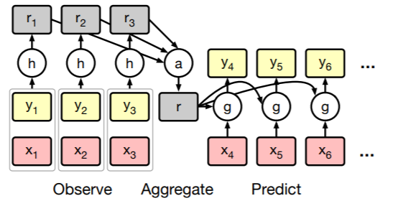
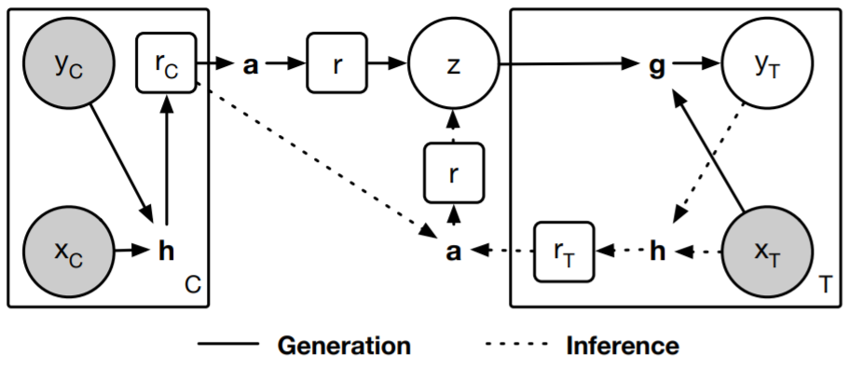
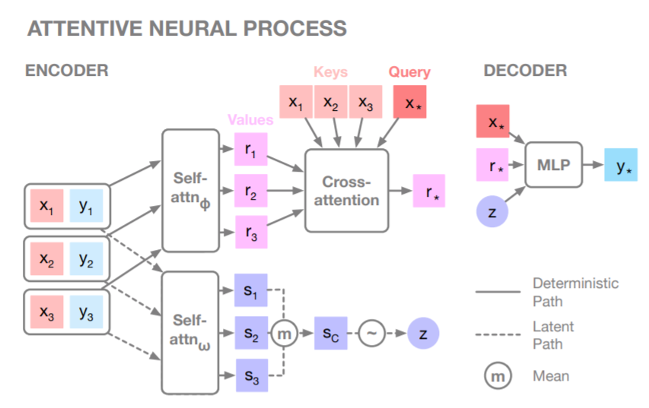
CONDITIONAL NEURAL PROCESS
NEURAL PROCESS

Slide 6
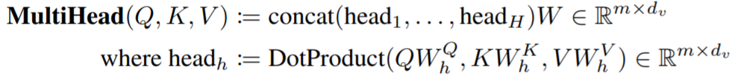
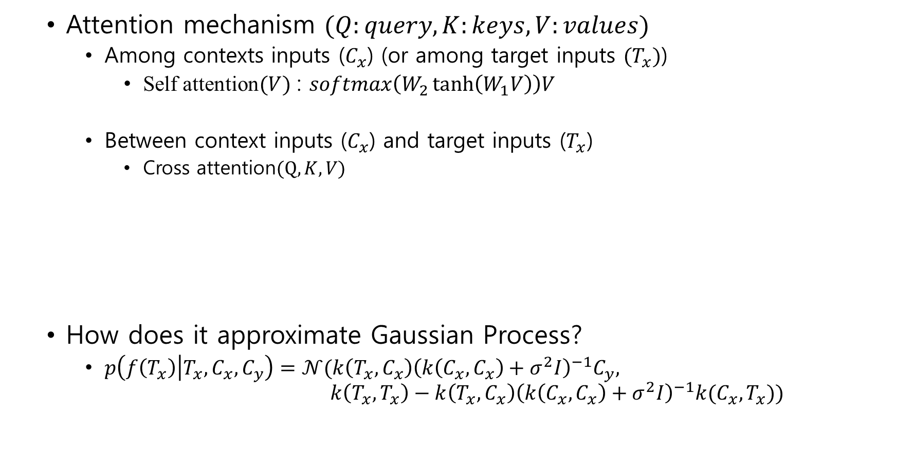
Attention mechanism $(Q:query, K:keys, V:values)$
Among contexts inputs ($C_{x}$) (or among target inputs ${(T}_{x})$)
Self attention$(V)$ : $softmax\left(W_{2}\tanh\left(W_{1}V\right)\right)V$
Between context inputs ($C_{x}$) and target inputs ($T_{x}$)
Cross attention$(Q,K,V)$
How does it approximate Gaussian Process?
$p\left(f\left(T_{x}\right) | T_{x},C_{x},C_{y}\right)=𝒩(k\left(T_{x},C_{x}\right){\left(k\left(C_{x},C_{x}\right)+σ^{2}I\right)}^{−1}C_{y},$ $k\left(T_{x}, T_{x}\right)−k\left(T_{x},C_{x}\right){\left(k\left(C_{x}, C_{x}\right)+σ^{2}I\right)}^{−1}k(C_{x},T_{x}))$

Slide 7
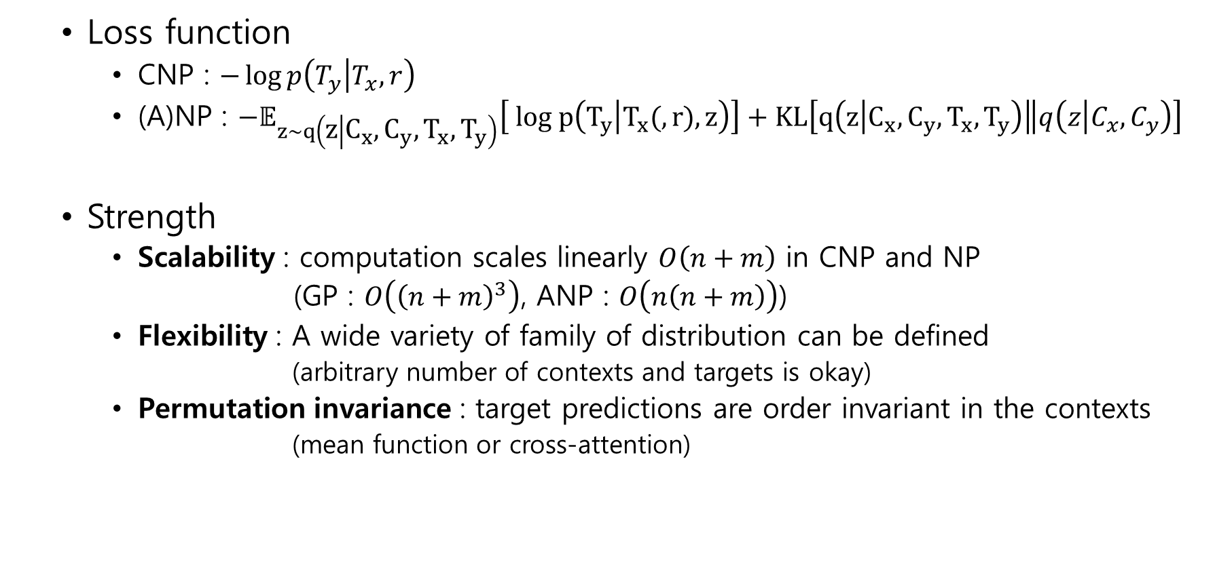
Loss function
CNP : $−\log{p\left(T_{y} | T_{x},r\right)}$
(A)NP : $−𝔼_{z\sim q\left(z | C_{x}, C_{y}, T_{x}, T_{y}\right)}\left[ log p\left(T_{y} | T_{x}(, r), z\right)\right]+KL\left[\left.q\left(z | C_{x},C_{y},T_{x}, T_{y}\right)\right\|q\left(z | C_{x},C_{y}\right)\right]$
Strength
Scalability : computation scales linearly $O\left(n+m\right)$ in CNP and NP
(GP : $O\left({\left(n+m\right)}^{3}\right)$, ANP : $O\left(n\left(n+m\right)\right)$)
Flexibility : A wide variety of family of distribution can be defined
(arbitrary number of contexts and targets is okay)
Permutation invariance : target predictions are order invariant in the contexts
(mean function or cross-attention)

Slide 8
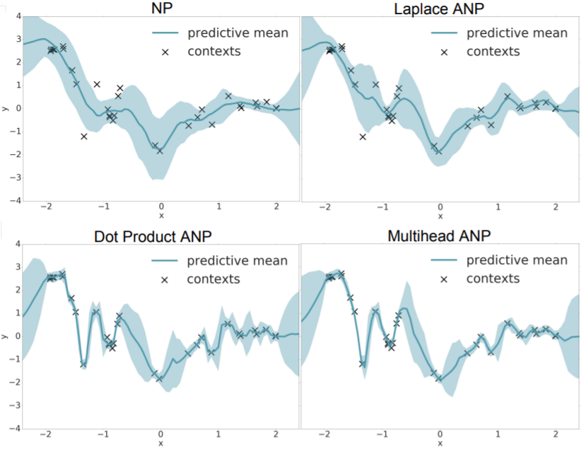
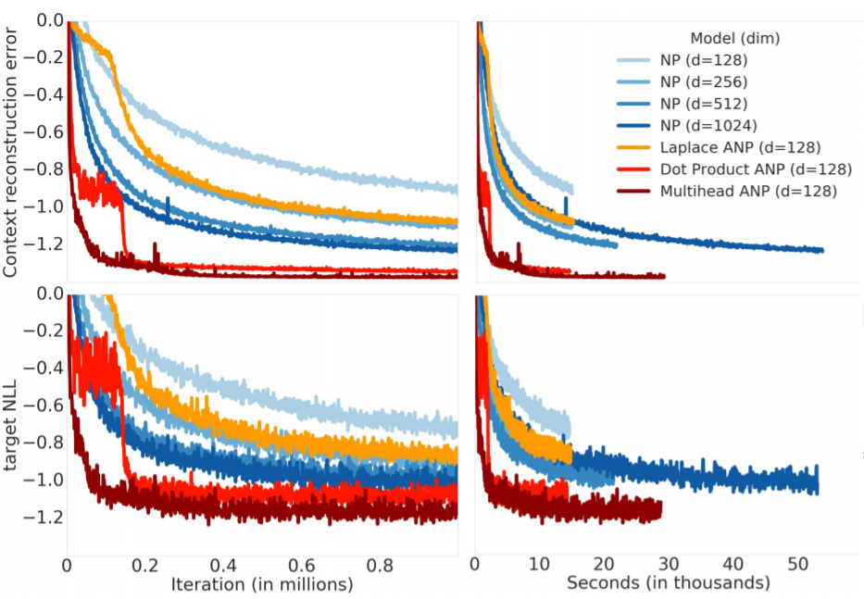
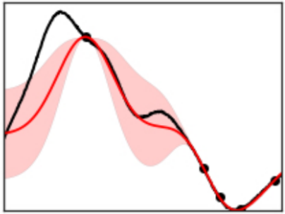
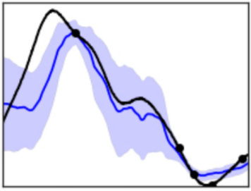
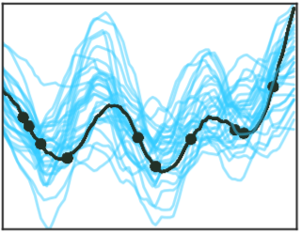
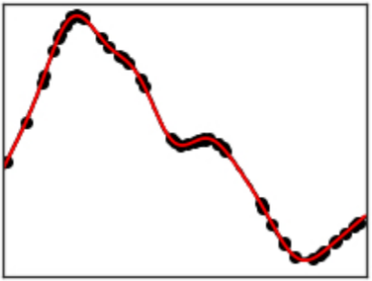
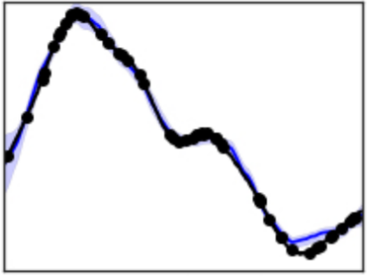
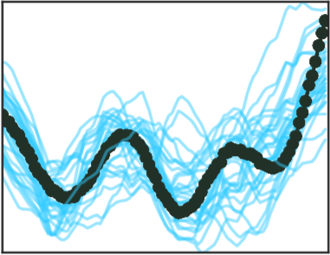
Variance decreases as the number of contexts increases.
Variance of CNP is sharper than that of GP.
CNP is deterministic if contexts and targets are fixed.
(A)NP can sample multiple functions by sampling different z.
NP is highly variable comparing to GP and CNP.
NP is underfitted even at predictions on context points.
ANP resolved the underfitting issue on NP.
ANP show nice convergence in terms of iterations and time.
GP
CNP
NP

Slide 9
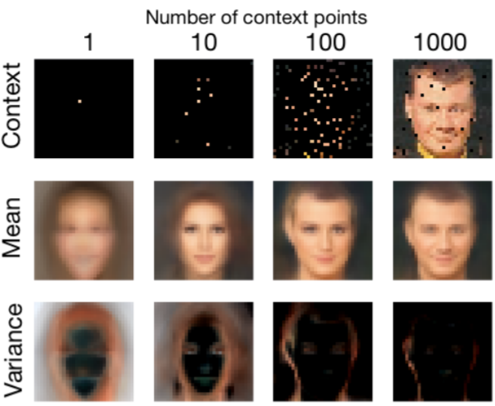
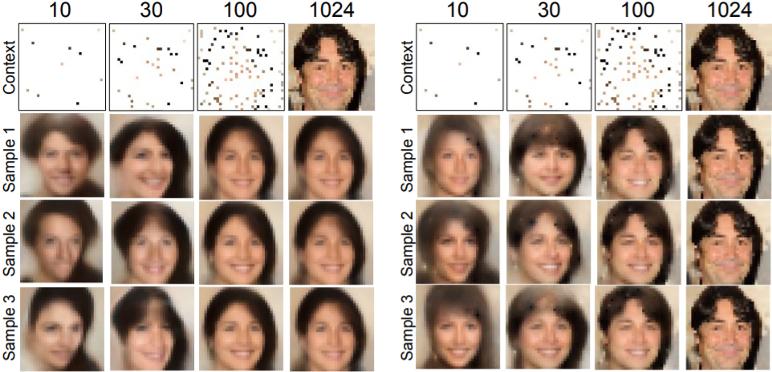
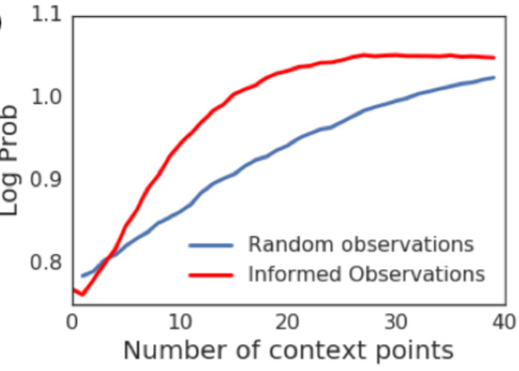
CNP
NP
ANP
Variance decreases as the number of contexts increases.
Variance of CNP is sharper than that of GP.
CNP is deterministic if contexts and targets are fixed.
(A)NP can sample multiple functions by sampling different z.
NP is highly variable comparing to GP and CNP.
NP is underfitted even at predictions on context points.
ANP resolved the underfitting issue on NP.
Choice of contexts by variance of target output boost training.
Log prob

Slide 10
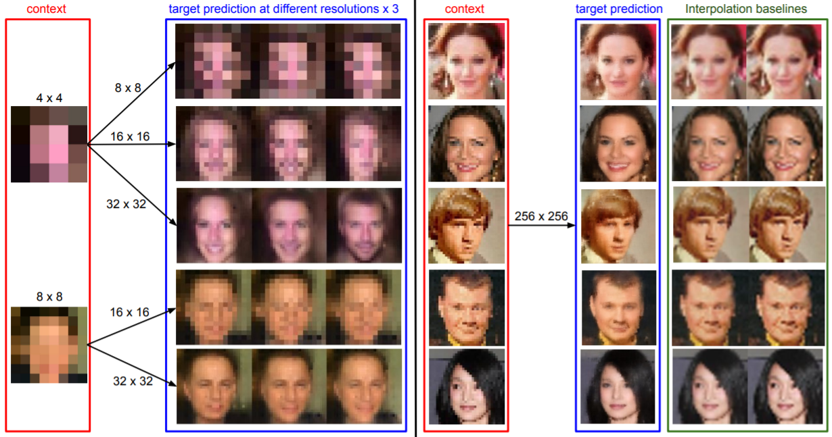
High resolution task cannot be done in generative models.
Show better performance than cubic interpolation baseline.

Slide 11
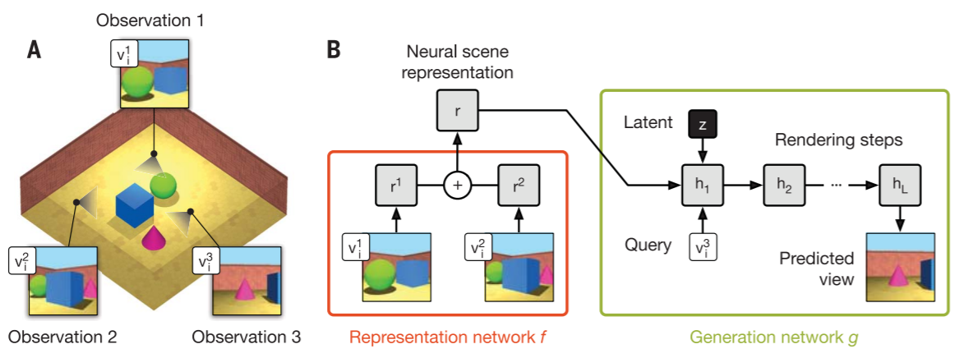
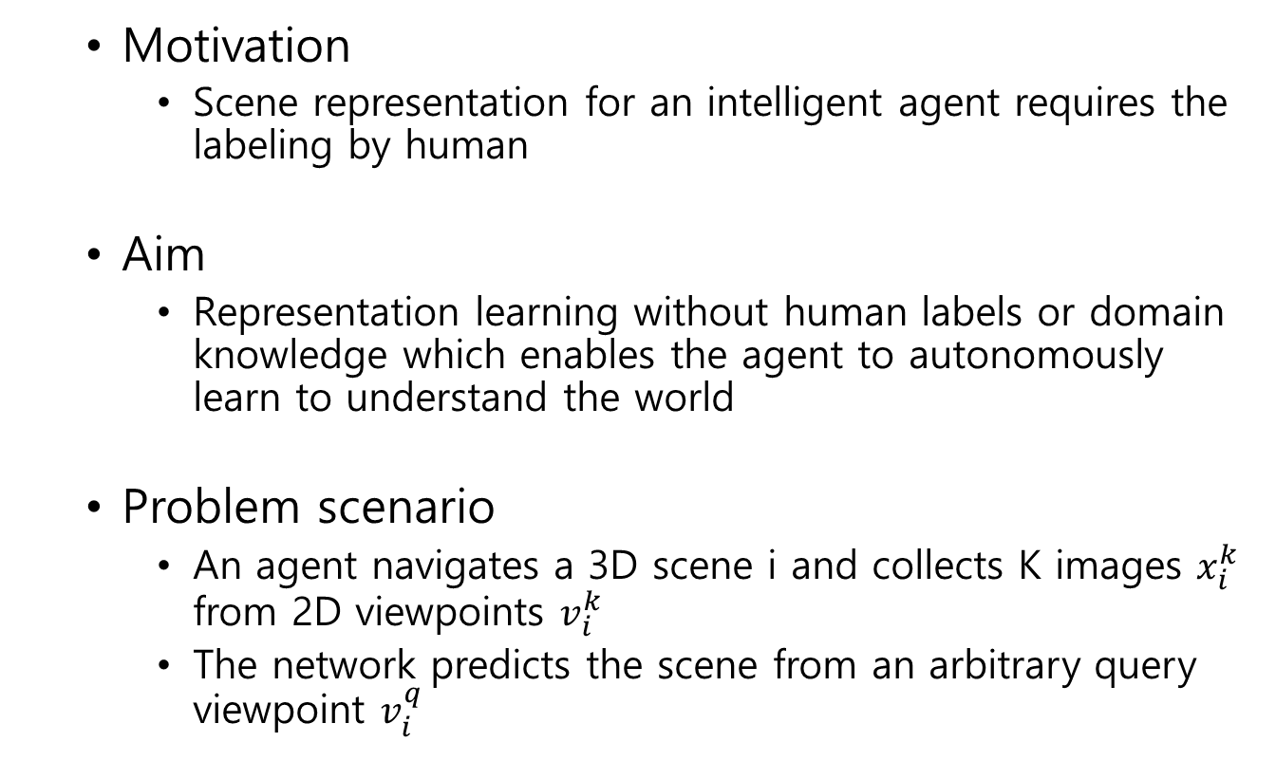
Generative Query Networks
Motivation
Scene representation for an intelligent agent requires the labeling by human
Aim
Representation learning without human labels or domain knowledge which enables the agent to autonomously learn to understand the world
Problem scenario
An agent navigates a 3D scene i and collects K images $x_{i}^{k}$ from 2D viewpoints $v_{i}^{k}$
The network predicts the scene from an arbitrary query viewpoint $v_{i}^{q}$

Slide 12
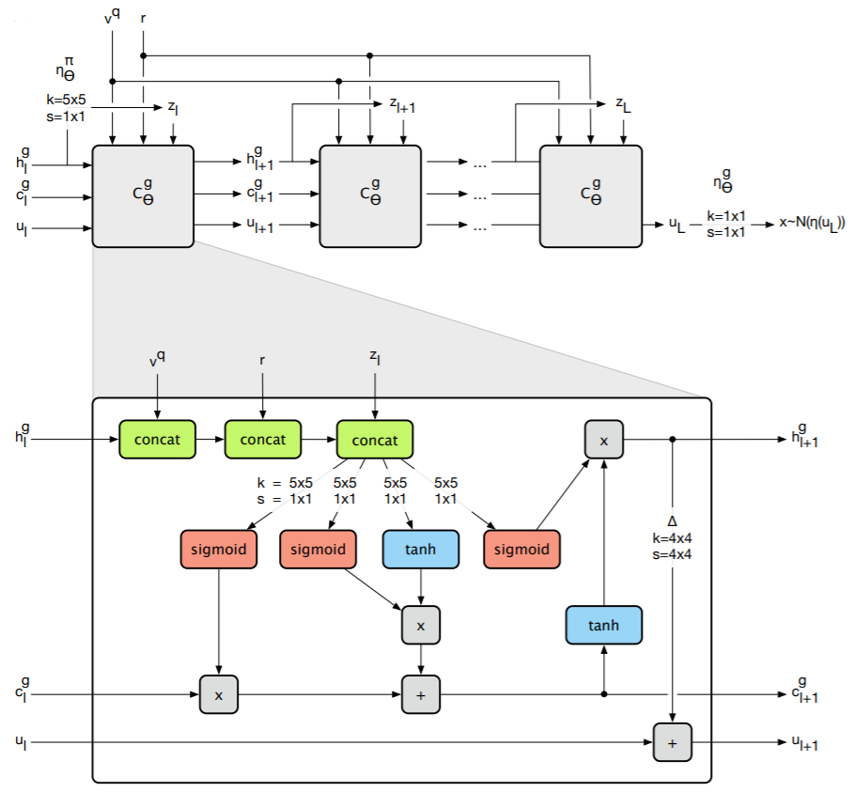
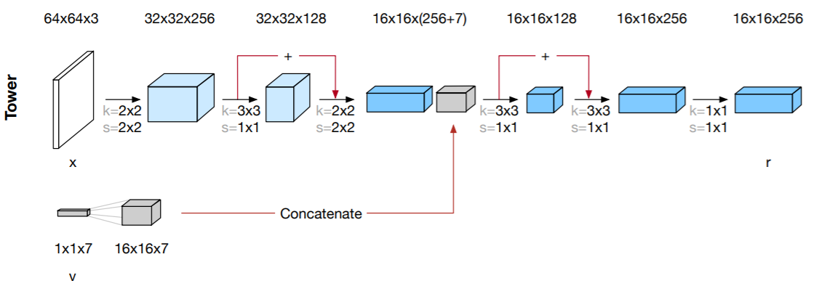
Architecture

Slide 13
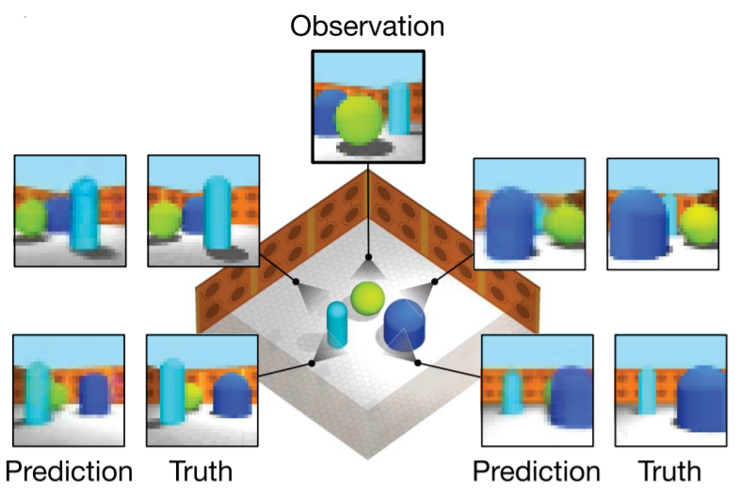
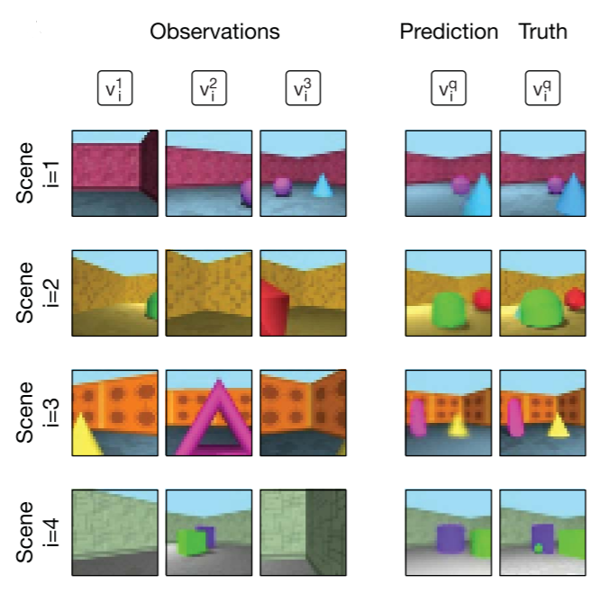
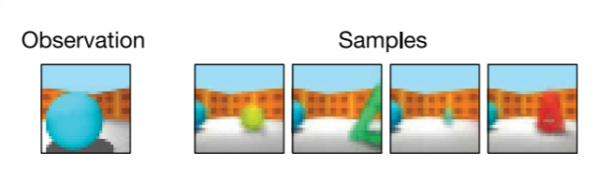
Prediction

Slide 14
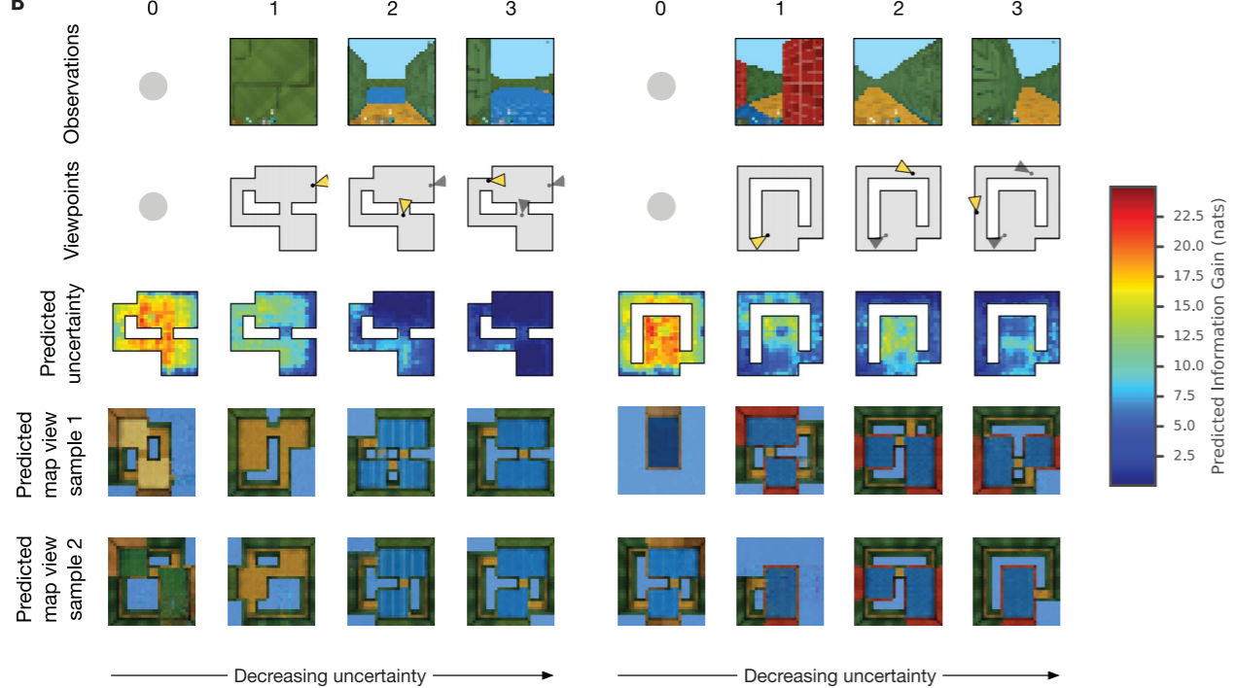

Slide 15
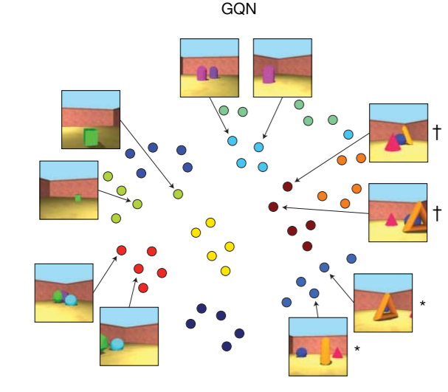
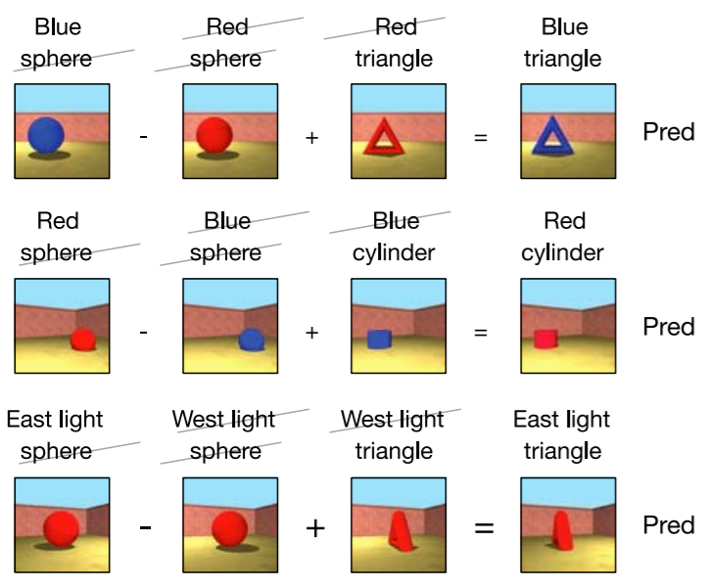
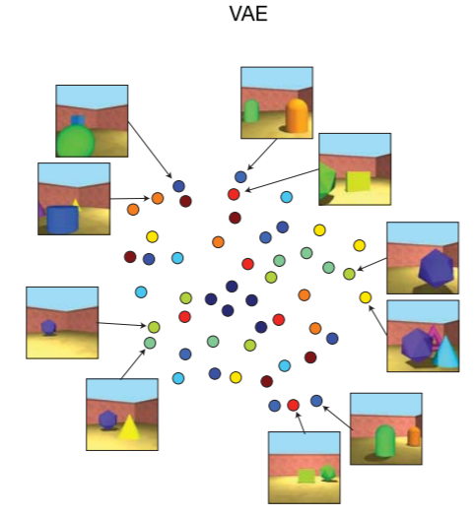
Representation
Algebra works in scene representation

Slide 16
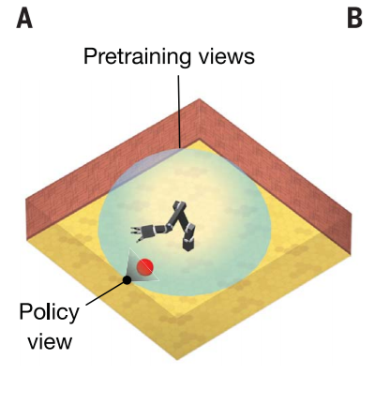
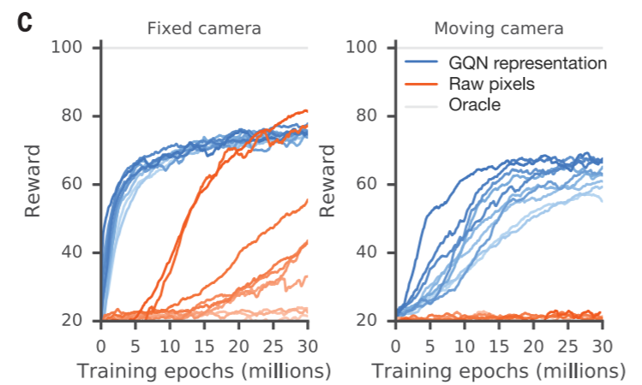
Data-efficient control
Goal is to learn to control a robotic arm to reach a randomly positioned colored object.
GQN is pretrained on randomized configurations from randomized viewpoints in the dome.
Controlling policy observes the scene from either fixed camera or moving camera.
Using GQN representation rather than raw pixel, required experiences decreases 4 times.

Slide 17
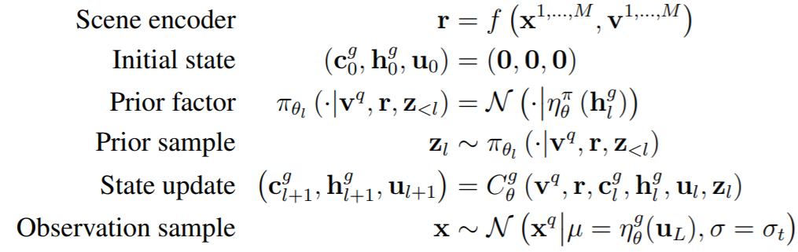
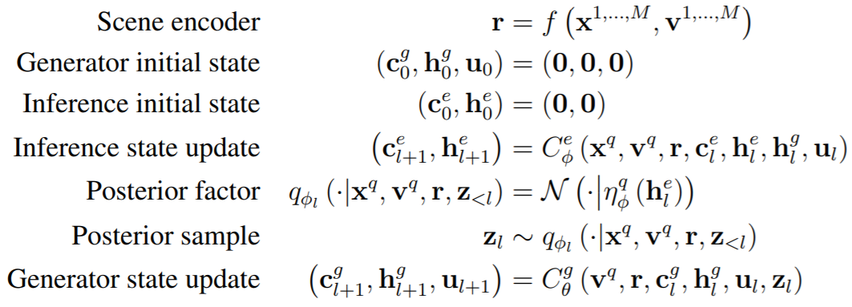
Generative
Inference
Latent variable z is sampled from the distribution that is conditioned on target input $v^{q}$.
Different target inputs take different latent variable, which results in inconsistent target outputs.

Slide 18
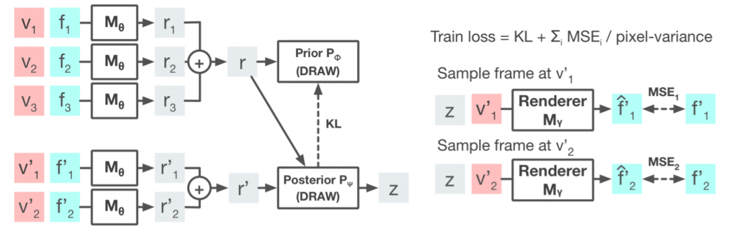
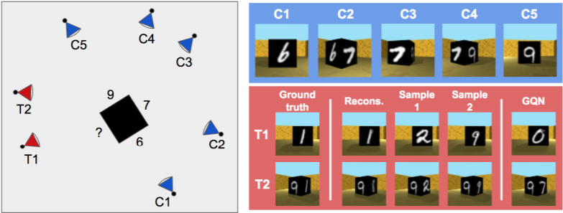
Consistent Generative Query Networks
Just as Neural Processes, a sampled latent variable is shared among target inputs.
Pixel variance plays the same role as KL-annealing to handle posterior collapse.

Slide 19
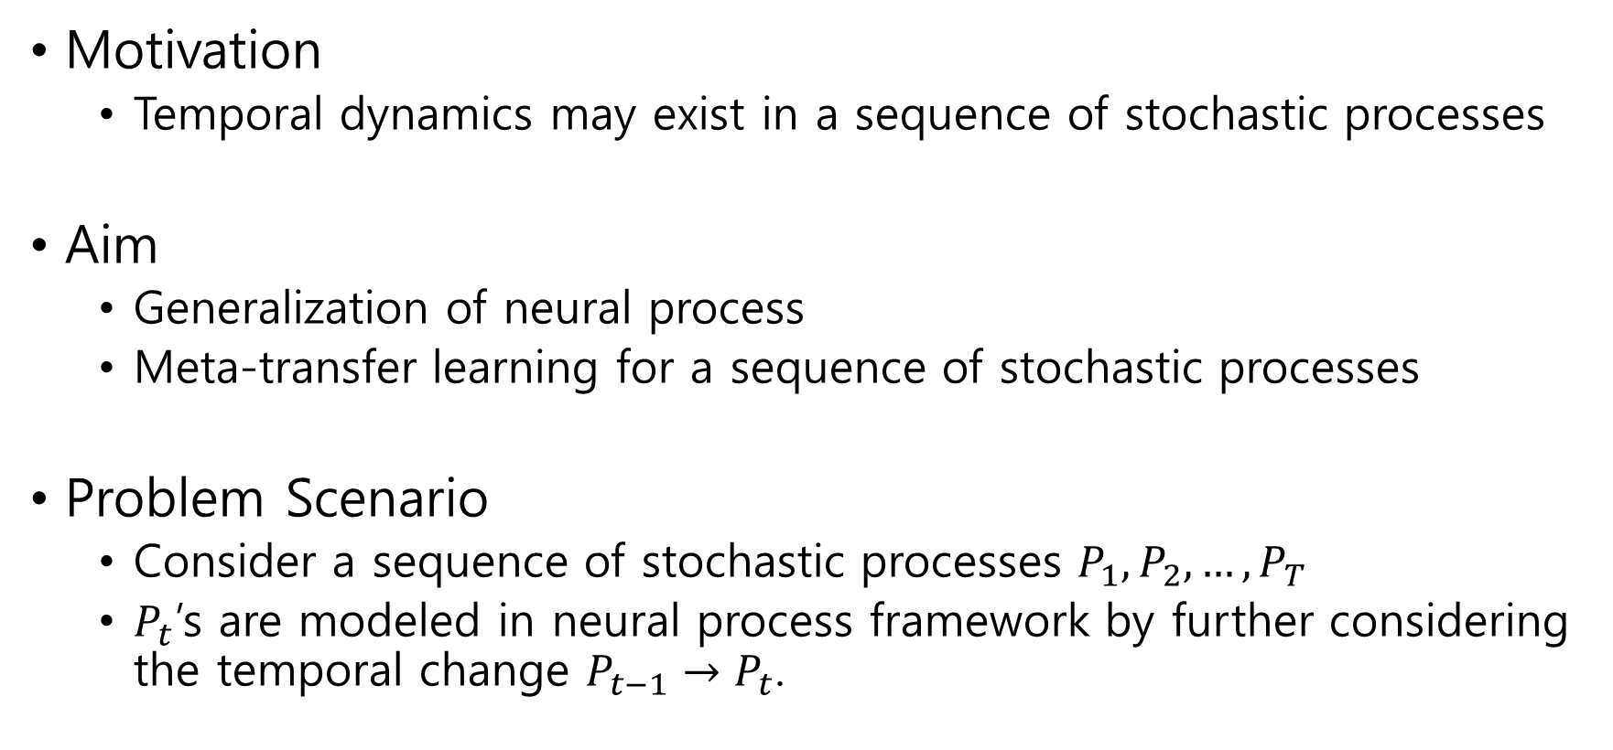
Sequential Neural Process
Motivation
Temporal dynamics may exist in a sequence of stochastic processes
Aim
Generalization of neural process
Meta-transfer learning for a sequence of stochastic processes
Problem Scenario
Consider a sequence of stochastic processes $P_{1}, P_{2},…, P_{T}$
$P_{t}$’s are modeled in neural process framework by further considering the temporal change $P_{t−1}→P_{t}$.

Slide 20
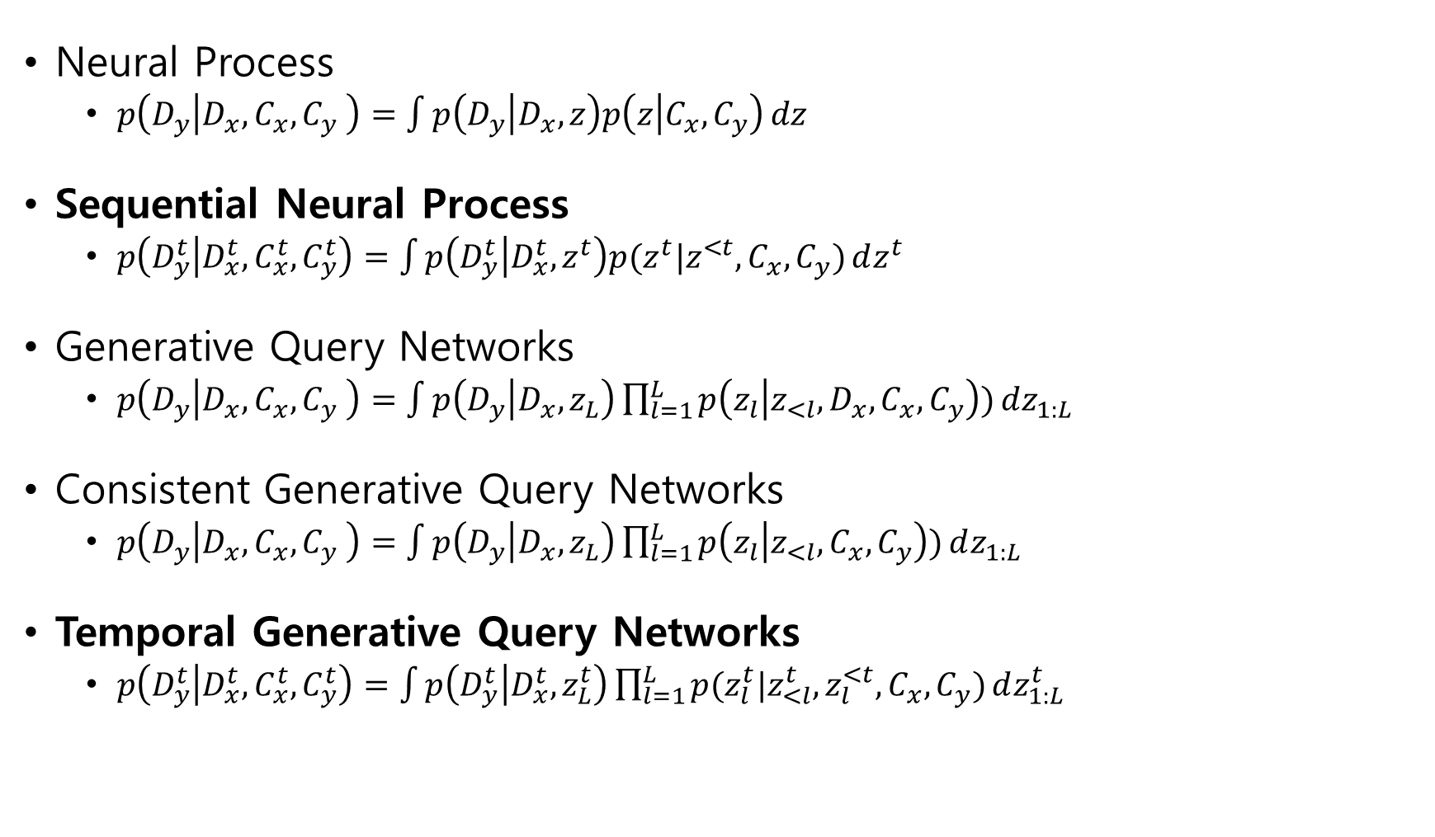
Model Comparison
Neural Process
$p\left(D_{y} | D_{x},C_{x},C_{y} \right)=\int{p\left(D_{y} | D_{x},z\right)p\left(z | C_{x},C_{y}\right)}dz$
Sequential Neural Process
$p\left(D_{y}^{t} | D_{x}^{t}, C_{x}^{t},C_{y}^{t}\right)=\int{p\left(D_{y}^{t} | D_{x}^{t},z^{t}\right)p(z^{t}|z^{<t},C_{x},C_{y})}dz^{t}$
Generative Query Networks
$p\left(D_{y} | D_{x},C_{x},C_{y} \right)=\int{p\left(D_{y} | D_{x},z_{L}\right)\prod_{l=1}^{L}{p\left(z_{l} | z_{<l}, D_{x},C_{x},C_{y}\right))}}dz_{1:L}$
Consistent Generative Query Networks
$p\left(D_{y} | D_{x},C_{x},C_{y} \right)=\int{p\left(D_{y} | D_{x},z_{L}\right)\prod_{l=1}^{L}{p\left(z_{l} | z_{<l}, C_{x},C_{y}\right))}}dz_{1:L}$
Temporal Generative Query Networks
$p\left(D_{y}^{t} | D_{x}^{t}, C_{x}^{t},C_{y}^{t}\right)=\int{p\left(D_{y}^{t} | D_{x}^{t},z_{L}^{t}\right)\prod_{l=1}^{L}{p(z_{l}^{t}|z_{<l}^{t}, z_{l}^{<t},C_{x},C_{y})}}dz_{1:L}^{t}$

Slide 21
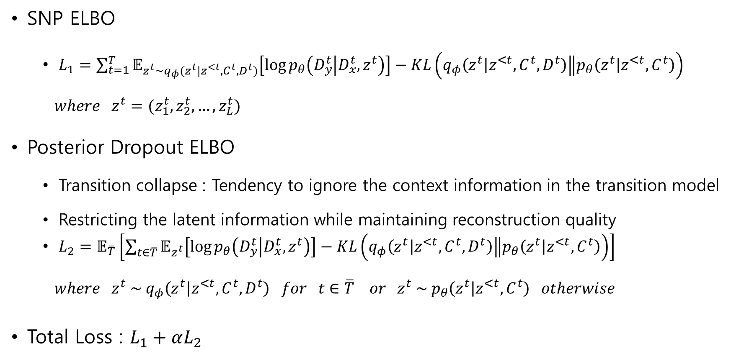
Loss function
SNP ELBO
$L_{1}=\sum_{t=1}^{T}{𝔼_{z^{t}\sim q_{φ}(z^{t}|z^{<t}, C^{t},D^{t})}\left[\log{p_{θ}\left(D_{y}^{t} | D_{x}^{t},z^{t}\right)}\right]−KL\left(\left.q_{φ}\left(z^{t} | z^{<t},C^{t},D^{t}\right)\right\|p_{θ}\left(z^{t} | z^{<t},C^{t}\right)\right)}$
$where z^{t}=(z_{1}^{t},z_{2}^{t},…,z_{L}^{t})$
Posterior Dropout ELBO
Transition collapse : Tendency to ignore the context information in the transition model
Restricting the latent information while maintaining reconstruction quality
$L_{2}=𝔼_{\overline{T}}\left[\sum_{t∈\overline{T}}{𝔼_{z^{t}}\left[\log{p_{θ}\left(D_{y}^{t} | D_{x}^{t},z^{t}\right)}\right]−KL\left(\left.q_{φ}\left(z^{t} | z^{<t},C^{t},D^{t}\right)\right\|p_{θ}\left(z^{t} | z^{<t},C^{t}\right)\right)}\right]$
$where z^{t} \sim q_{φ}\left(z^{t} | z^{<t},C^{t},D^{t}\right) for t∈\overline{T} or z^{t} \sim p_{θ}\left(z^{t} | z^{<t},C^{t}\right) otherwise$
Total Loss : $L_{1}+αL_{2}$

Slide 22
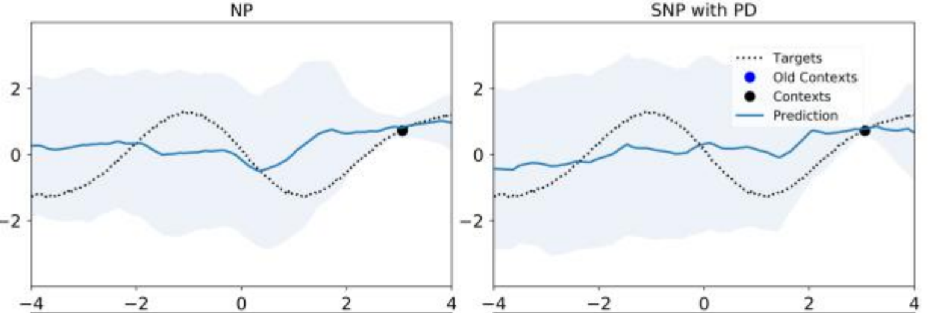
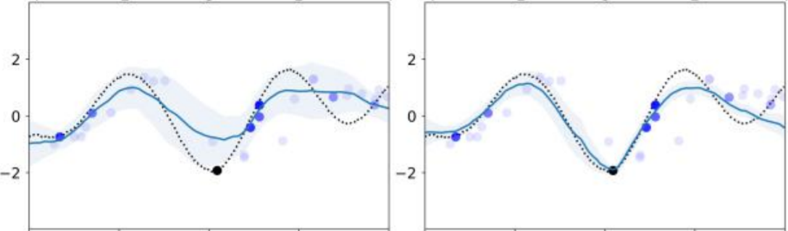
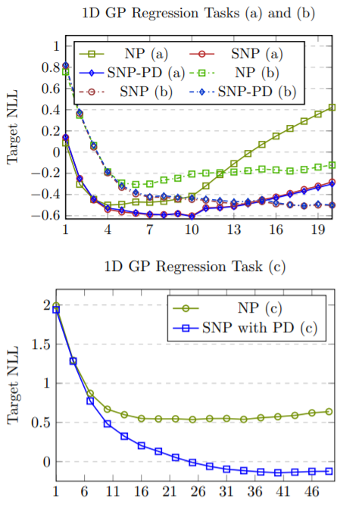
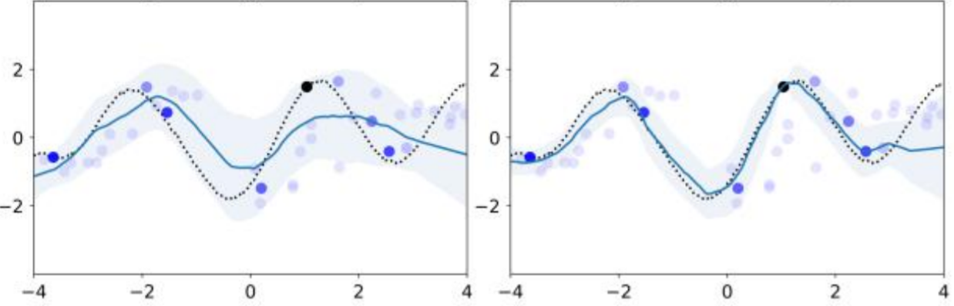
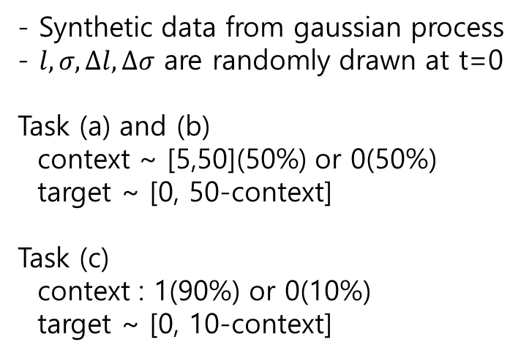
- Synthetic data from gaussian process
- $l,σ, ∆l,∆σ$ are randomly drawn at t=0
Task (a) and (b)
context ~ [5,50](50%) or 0(50%)
target ~ [0, 50-context]
Task (c)
context : 1(90%) or 0(10%)
target ~ [0, 10-context]

Slide 23
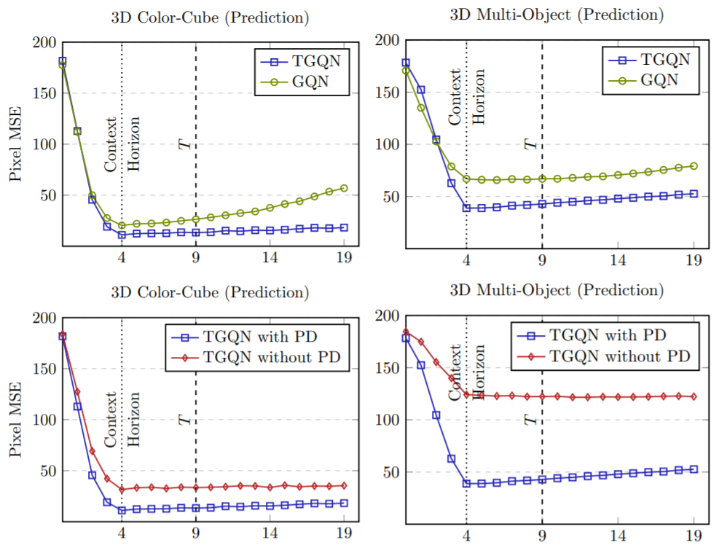
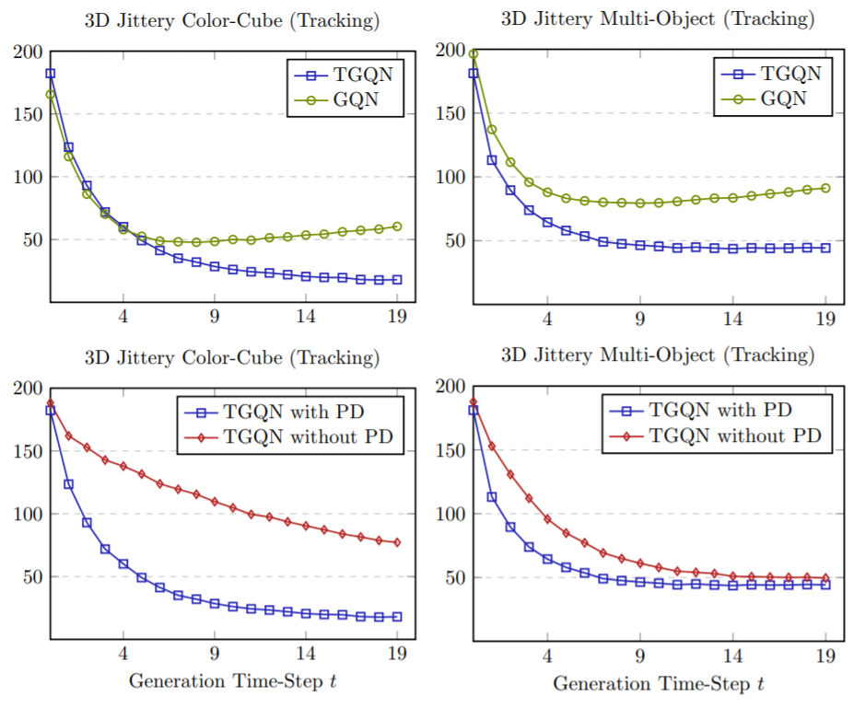
Prediction
Tracking
Up to 4 observations in first 5 steps
Up to 2 observations in every step

Slide 24
